Slide 1
Ch. 10
Infinite Impulse Response (IIR) Digital Filters

Slide 2
Outline
Introduction
IIR Theory
IIR Coefficient Computation
IIR Filter Implementation
Fast IIR Filter

Slide 3
Introduction
The most important properties that make the FIR attractive (+) or unattractive (−) for selective applications include:
+ FIR linear-phase performance is easily achieved.
+ Multiband filters are possible.
+ The Kaiser window method allows iterative-free design.
+ FIRs have a simple structure for decimators and interpolators
+ Nonrecursive filters are always stable and have no limit cycles.
+ It is easy to get high-speed, pipelined designs.
+ FIRs typically have low coefficient and arithmetic roundoff error budgets, and well-defined quantization noise.
− Recursive FIR filters may be unstable because of imperfect pole/zero annihilation.
− The sophisticated Parks–McClellan algorithms must be available for minimax filter design.
− High filter length requires high implementation effort.

Slide 4
Compared to an FIR filter, an IIR filter can often be much more efficient in terms of attaining certain performance characteristics with a given filter order. This is because the IIR filter incorporates feedback and is capable of realizing both zeros and poles of a system transfer function, whereas the FIR filter is an all-zero filter. In this chapter, the fundamentals of IIR filter design will be developed.
The traditional approach to the design of IIR filters involves the transformation of an analog filter, with defined feedback specifications, into the digital domain. This is a reasonable approach, mainly because the art of designing analog filters is highly advanced, and many standard tables are available,
We will review the four most important classes of these analog prototype filters in this chapter, namely Butterworth, Chebyshev I and II, and elliptic filters.

Slide 5
The IIR will be shown to overcome many of the deficiencies of the FIR, but to have some less desirable properties as well. The general desired (+) and undesired (−) properties of an IIR filter are:
+ Standard design using an analog prototype filter is well understood.
+ Highly selective filters can be realized with low-order designs that can run at high speeds.
+ Design using tables and a pocket calculator is possible.
+ For the same tolerance scheme, filters are short, compared with FIR filters.
+ Closed-loop design algorithms can be used.
− Nonlinear-phase response is typical, i.e., it is difficult to get linear-phase response. (Using an allpass filter for phase compensation results in twice the complexity.)
− Limit cycles may occur for integer implementation.
− Multiband design is difficult; only low, high, or bandpass filters are designed.
− Feedback can introduce instabilities. (Most often, the mirror pole to the unit circle can be used to produce the same magnitude response, and the filter will be stable.)
− It is more difficult to get high-speed, pipelined designs

Slide 6

Example 11.1: Lossy Integrator I
One of the basic tasks of a filter may be to smooth a noisy signal. Assume that a signal x[n] is received in the presence of wideband zero-mean random noise. Mathematically, an integrator could be used to suppress the effects of the noise. If the average value of the input signal is to be preserved over a finite time interval, a lossy integrator is often used to process the signal with additive noise.
Figure 11.1 displays a simple first-order lossy integrator that satisfies the discrete-time difference equation:
As we can see from the impulse response in Fig. 11.2a, the same functionality of the first-order lossy integrator can be achieved with a 15-tap FIR filter. The step response to the lossy integrator is shown in Fig. 11.2b.

Slide 7
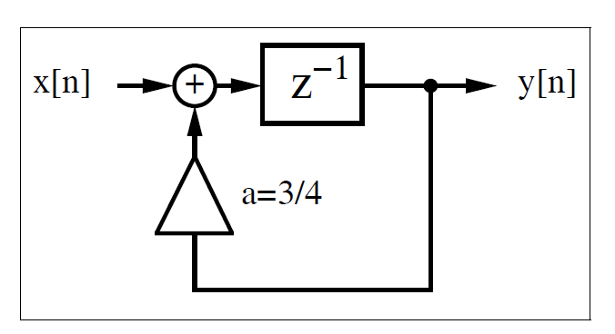
Fig. 11.1. First-order IIR filter used as lossy integrator.

Slide 8
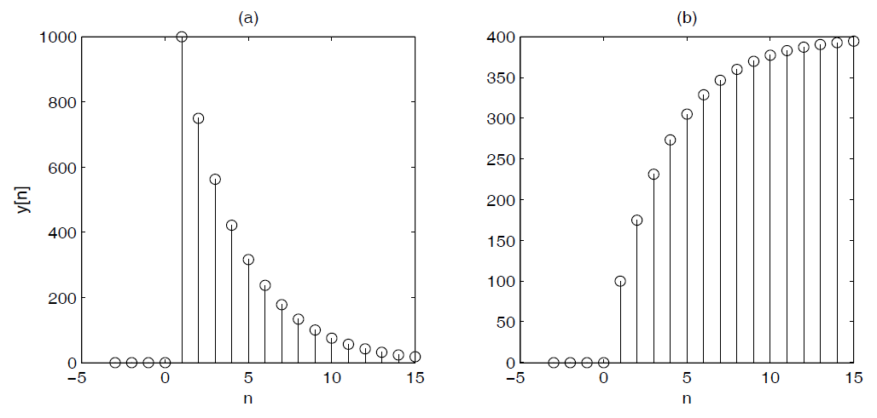
Fig. 112. Simulation of lossy integrator with a = 3/4. (a) Impulse response for x[n] = 1000δ[n]. (b) Step response for x[n] = 100σ[n].

Slide 9
The following VHDL code shows a possible implementation of this IIR filter.
PACKAGE n_bit_int IS -- User-defined type
SUBTYPE BITS15 IS INTEGER RANGE -2**14 TO 2**14-1;
END n_bit_int;
LIBRARY work;
USE work.n_bit_int.ALL;
LIBRARY ieee;
USE ieee.std_logic_1164.ALL;
USE ieee.std_logic_arith.ALL;
ENTITY iir IS
PORT (x_in : IN BITS15; -- Input
y_out : OUT BITS15; -- Result
clk : IN STD_LOGIC);
END iir;
ARCHITECTURE fpga OF iir IS
SIGNAL x, y : BITS15 := 0;
BEGIN
PROCESS -- Use FF for input and recursive part
BEGIN
WAIT UNTIL clk = ’1’;
x <= x_in;
y <= x + y / 4 + y / 2;
end process;
y_out <= y; -- Connect y to output pins
END fpga;

Slide 10
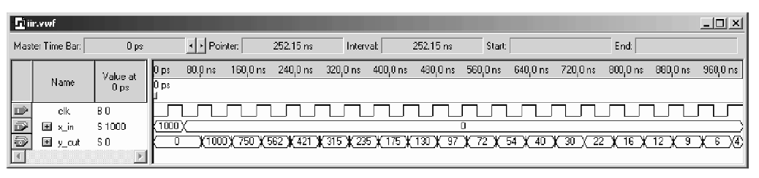
Registers have been implemented using a WAIT statement inside a PROCESS block, while the multiplication and addition is implemented using CSD code.
The design uses 62 LEs, no embedded multiplier, and has a 160.69MHz Registered Performance, if synthesized with the Speed option. The response of the filter to an impulse of amplitude 1000, shown in Fig. 11.3, agrees with the MatLab simulated results presented in Fig. 11.2a.
An alternative design approach using a “standard logic vector” data type and LPM_ADD_SUB megafunctions. This second approach will produce longer VHDL code but will have the benefit of direct control, at the bit level, over the sign extension and multiplier.
Fig. 11.3. Impulse response for Quartus II simulation of the lossy integrator.

Slide 11
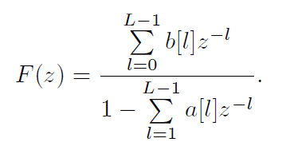
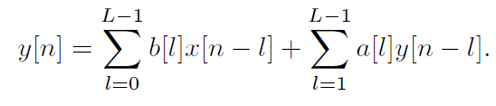
11.1 IIR Theory
A nonrecursive filter incorporates, as the name implies, no feedback. The impulse response of such a filter is finite, i.e., it is an FIR filter. A recursive filter, on the other hand has feedback, and is expected, in general, to have an infinite impulse response, i.e., to be an IIR filter. Figure 11.4a shows filters with separate recursive and nonrecursive parts. A canonical filter is produced if these recursive and nonrecursive parts are merged together, as shown in Fig. 11.4b. The transfer function of the filter from Fig. 11.4 can be written as:
The difference equation for such a system yields:

Slide 12
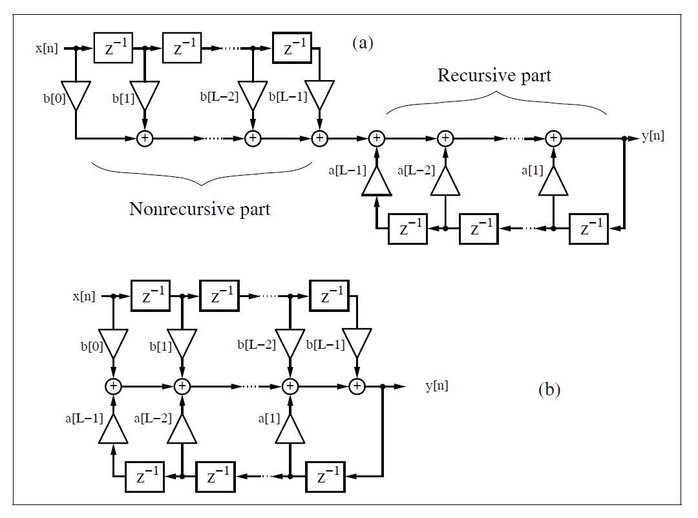
Fig. 11.4. Filter with feedback.

Slide 13
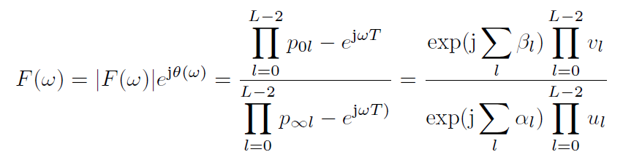
Comparing this with the difference equation for the FIR filter, we find that the difference equation for recursive systems depends not only on the L previous values of the input sequence x[n], but also on the L − 1 previous values of y[n].
If we compute poles and zeros of F(z), we see that the nonrecursive part, i.e., the numerator of F(z), produces the zeros p0l, while the denominator of F(z) produces the poles p∞l.
For the transfer function, the pole/zero plot can be used to look up the most important properties of the filter. If we substitute z = e^{jωT} in the z-domain transfer function, we can construct the Fourier transfer function by graphical means.

Slide 14
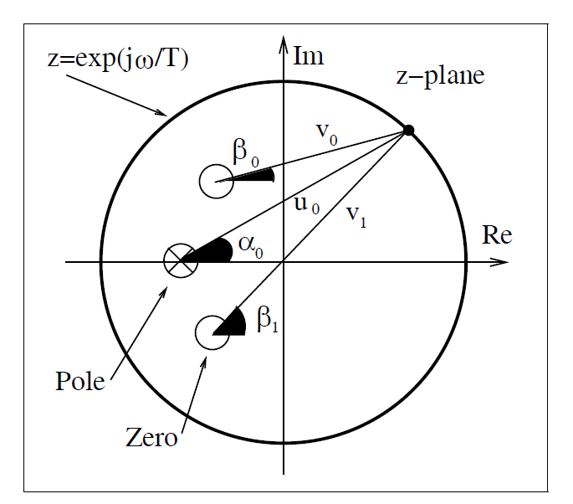
Fig. 11.5. Computation of transfer function using the pole/zero plot. Amplitude gain = v₀v₁/u₀, phase gain = β₀ + β₁ − α₀.

Slide 15
Using the connection between the transfer function in the Fourier domain and the pole/zero plot, we can already deduce several properties:
  1) A zero on the unit circle p0 = e^{jω0T} (with no annihilating pole) produces a zero in the transfer function in the Fourier domain at the frequency ω0.
  2) A pole on the unit circle p∞ = e^{jω0T} (and no annihilating zero) produces an infinite gain in the transfer function in the Fourier domain at the frequency ω0.
  3) A stable filter with all poles inside the unit circle can have any type of input signal.
  4) A real filter has single poles and zeros on the real axis, while complex poles and zeros appear always in pairs, i.e., if a0 + ja1 is a pole or zero, a0 − ja1 must also be a pole or zero.
  5) A linear-phase (i.e., constant group delay) filter has all poles and zeros symmetric to the unit circle or at z = 0.

Slide 16
If we combine observations 3 and 5, we find that, for a stable linear-phase system, all zeros must be symmetric to the unit circle and only poles at z = 0 are permitted.
An IIR filter (with poles z = 0) can therefore be only approximately linear-phase. To achieve this approximation a well-known principle from analog filter design is used: an allpass has a unit gain, and introduces a nonzero

Slide 17

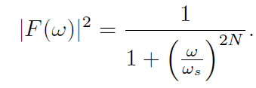
11.2 IIR Coefficient Computation
In classical IIR design, a digital filter is designed that approximates an ideal filter. The ideal digital filter model specifications are mathematically converted into a set of specifications from an analog filter model using the bilinear z-transform given by:
A classic analog Butterworth, Chebyshev, or elliptic model can be synthesized from these specifications, and is then mapped into a digital IIR using this bilinear z-transform.
An analog Butterworth filter has a magnitude-squared frequency response given by:

Slide 18
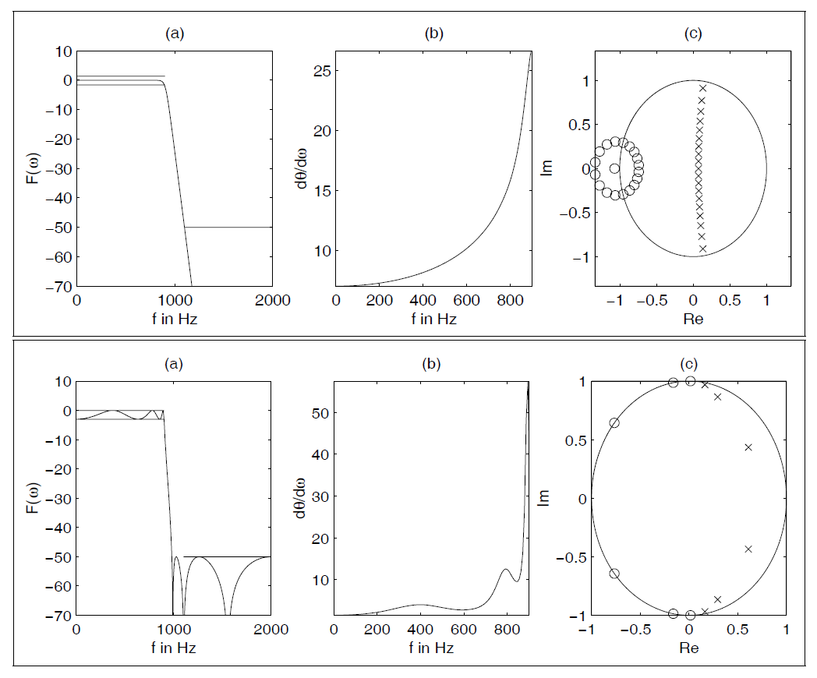
Fig. 11.6. Filter design with MatLab toolbox. (upper) Butterworth filter and (lower) elliptic Filter.
(a) Transfer function. (b) Group delay of passband. (c) Pole/zero plot. (× = pole; ◦ = zero).

Slide 19
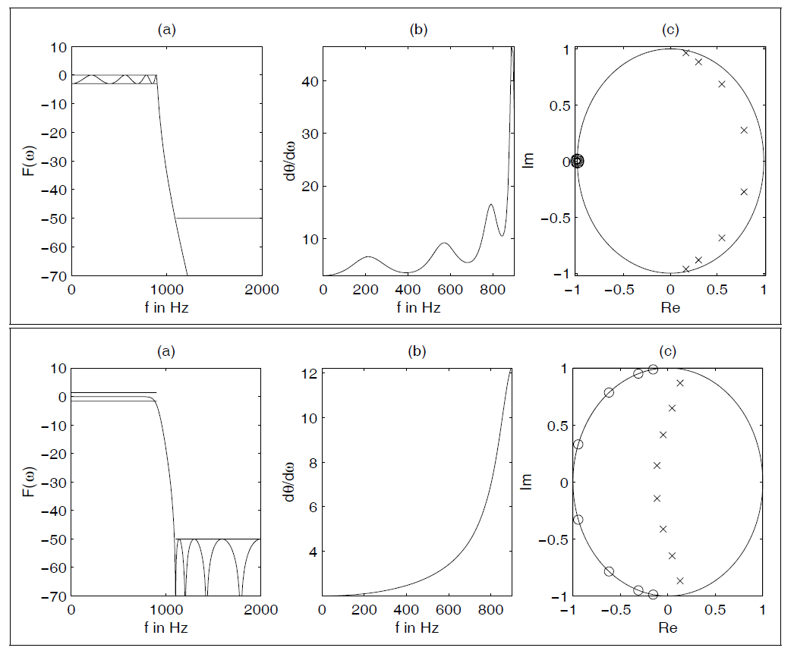
Fig. 11.7. Chebyshev filter design with MatLab toolbox. Chebyshev I (upper) and Chebyshev II (lower).
(a) Transfer function. (b) Group delay of passband. (c) Pole/zero plot (× = pole;
◦ = zero).

Slide 20
11.2.1 Summary of Important IIR Design Attributes
The attributes of classic IIR types are summarized as follows:
  Butterworth: Maximally flat passband, flat stopband, wide transition band
  Chebyshev I: Equiripple passband, flat stopband, moderate transition band
  Chebyshev II: Flat passband, equiripple stopband, moderate transition band
  Elliptic: Equiripple passband, equiripple stopband, narrow transition band

Slide 21
For a given set of filter requirement, the following observations
generally hold:
Filter order
  Lowest: Elliptic
  Medium: Chebyshev I or II
  Highest: Butterworth
Passband characteristics
  Equiripple: Elliptic, Chebyshev I
  Flat: Butterworth, Chebyshev II
Stopband characteristics
  Equiripple: Elliptic, Chebyshev II
  Flat: Butterworth, Chebyshev I
Transition band characteristics
  Narrowest: Elliptic
  Medium: Chebyshev I+II
  Widest: Butterworth

Slide 22
11.3 IIR Filter Implementation
Obtaining an IIR transfer function is generally considered to be a straightforward exercise, especially if design software like MatLab is used.
IIR filters can be developed in the context of many architectures. The most important structures are summarized as follows:
  Direct I form (see Fig. 11.8)
  Direct II form (see Fig. 11.9)
  Cascade of first- or second-order systems (see Fig. 11.10a)
  Parallel implementation of first- or second-order systems (see Fig. 11.10b).
  BiQuad implementation of a typical second-order section found in basic cascade or parallel designs (see Fig. 11.11)
  Normal , i.e., cascade of first- or second-order state variable systems (see Fig. 11.10a)

Slide 23
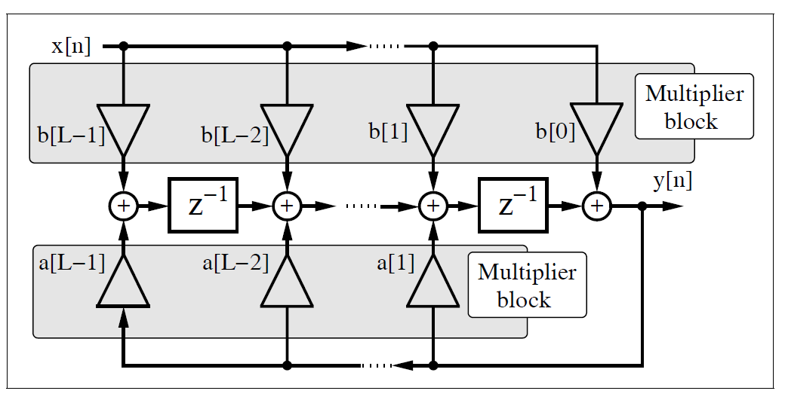
Fig. 11.8. Direct I form IIR filter using multiplier blocks.

Slide 24
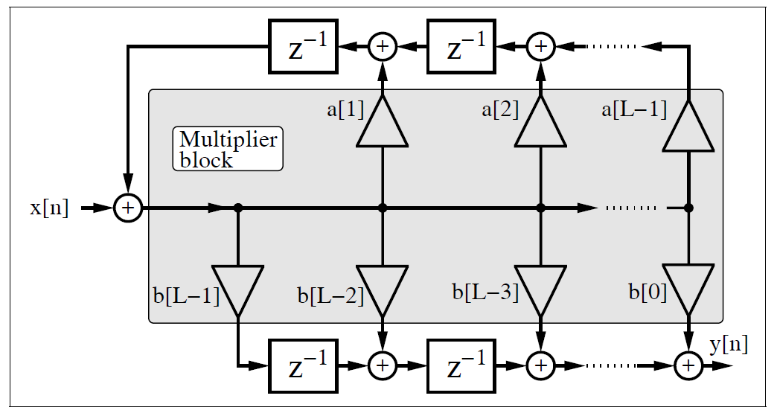
Fig. 11.9. Direct II form IIR filter using multiplier blocks.

Slide 25
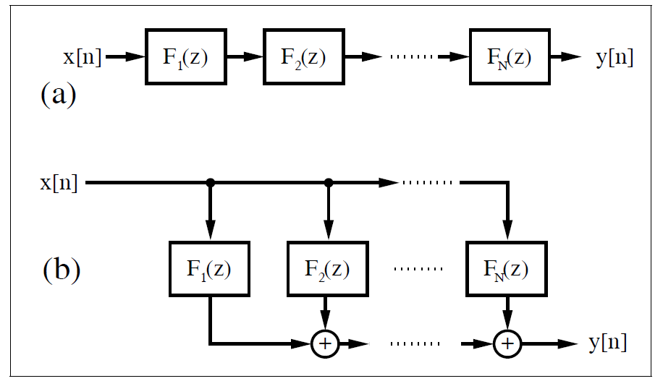
Fig. 11.10.

Slide 26
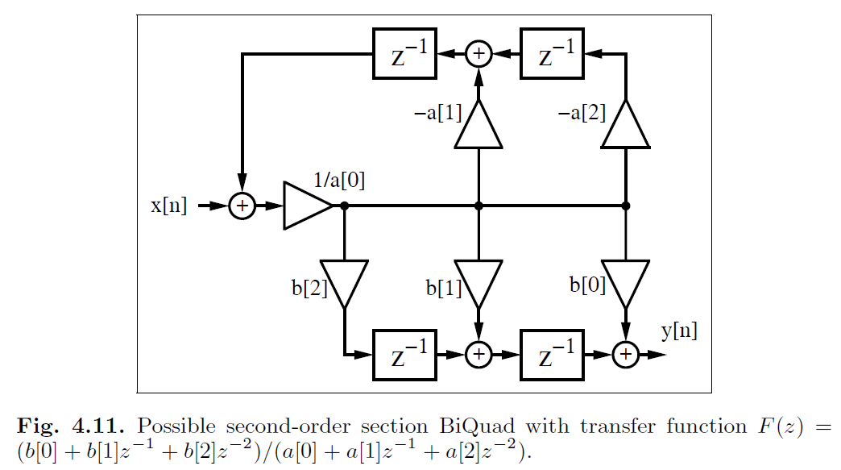
Fig. 11.11.

Slide 27
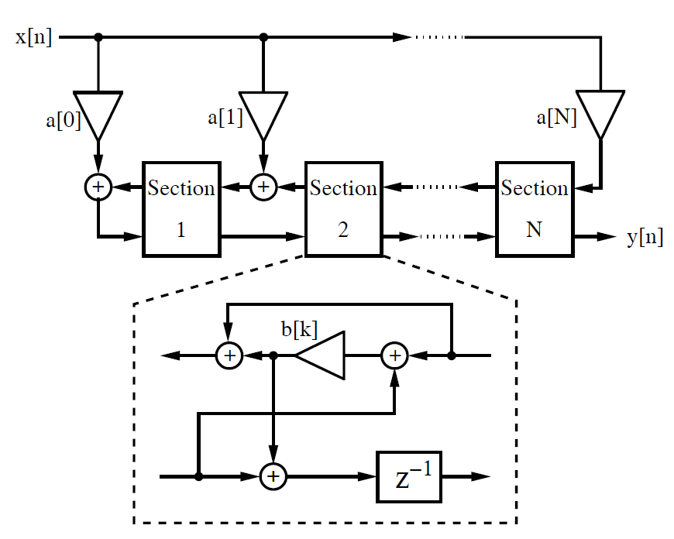
Fig. 11.12. Lattice filter.

Slide 28
  Parallel normal, i.e., parallel first- or second-order state variable systems (see Fig. 11.10b)
  Continued fraction structures
  Lattice filter (after Gray–Markel, see Fig. 11.12)
  Wave digital implementation (after Fettweis )
  General state space filter

Slide 29
Each architecture serves a unique purpose. Some of the general
selection rules are summarized below:
Speed
  High: Direct I & II
  Low: Wave
Fixed-point arithmetic roundoff error sensitivity
  High: Direct I & II
  Low: Normal, Lattice
Fixed-point coefficient roundoff error sensitivity
  High: Direct I & II
  Low: Parallel, Wave
Special properties
  Orthogonal weight outputs: Lattice
  Optimized second-order sections: Normal
  Arbitrary IIR specification: State variable

Slide 30
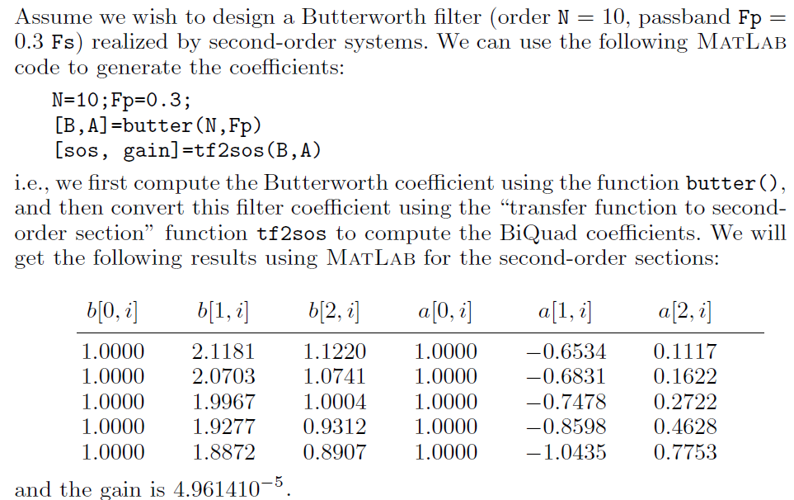
Example 11.2: Butterworth Second-order System

Slide 31
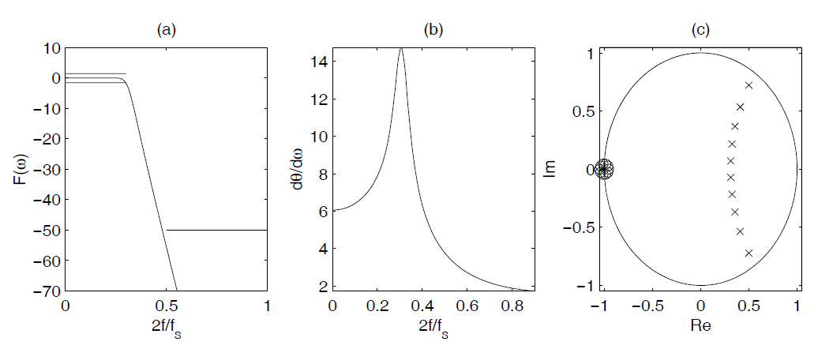
Figure 11.13 shows the transfer function, group delay, and the pole/zero plot of the filter. Note that all zeros are near z0i = −1, which can also be seen from the numerator coefficients of the second-order systems. Note also the rounding error in b[1, i] = 2 and b[0, i] = b[2, i] = 1.
Fig. 11.13. Tenth-order Butterworth filter showing (a) magnitude, (b) phase, and (c) group delay response.

Slide 32
11.3.1 Finite Wordlength Effects
Crochiere and Oppenheim have shown that the coefficient wordlength required for a digital filter is closely related to the coefficient sensitivities.
Implementation of the same IIR filter can therefore lead to a wide range of required wordlengths. To illustrate some of the dynamics of this problem, consider an eighth-order elliptic filter analyzed by Crochiere and Oppenheim. The resulting eighth-order transfer function was implemented with a Wave, Cascade, Parallel, Lattice, Direct I and II, and Continuous Fraction architecture.
The estimated coefficient wordlength to meet a specific maximal passband error criterion was conservatively estimated as shown in the second column of Table 11.1. As a result, it can be seen that the Direct form needs more wordlength than the Wave or Parallel structure. This has led to the conclusion that a Wave structure gives the best complexity (MW) in terms of the bit-width (W) multiplier product (M), as can be seen from column six of Table 11.1.

Slide 33
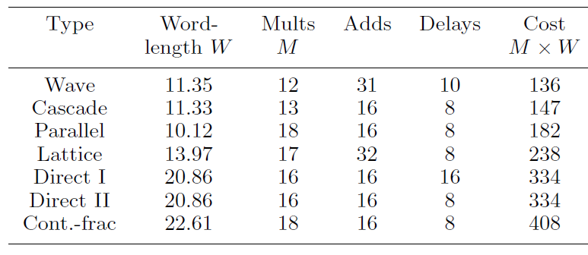
Table 11.1. Data for eighth-order elliptic filter by Crochiere and Oppenheim sorted according the costs M × W.

Slide 34
11.4 Fast IIR Filter
In Chap. 10, FIR filter Registered Performance was improved using pipelining. In the case of FIR filters, pipelining can be achieved at essentially no cost.
Pipelining IIR filters, however, is more sophisticated and is certainly not free. Simply introducing pipeline registers for all adders will, especially in the feedback path, very likely change the pole locations and therefore the transfer function of the IIR filter. However strategies that do not change the transfer function and still allow a higher throughput have been reported in the literature.
The reported methods that look promising to improve IIR filter throughput are:
  Look-ahead interleaving in the time domain
  Clustered look-ahead pole/zero assignment
  Scattered look-ahead pole/zero assignment
  IIR decimation filter design
  Parallel processing
  RNS implementation

Slide 35
The first five methods are based on filter architecture or signal flow techniques, and the last is based on computer arithmetic.
These techniques will be demonstrated with examples. To simplify the VHDL representation of each case, only a first-order IIR filter will be considered, but the same ideas can be applied to higher-order IIR filters and can be found in the literature references.

Slide 36
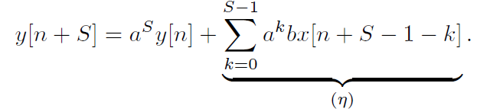
11.4.1 Time-domain Interleaving
Consider the differential equation of a first-order IIR system, namely
y[n + 1] = ay[n] + bx[n]. (11.10)
The output of the first-order system, namely y[n + 1], can be computed using a look-ahead methodology by substituting y[n+1] into the differential equation for y[n + 2]. That is
y[n + 2] = ay[n + 1]+bx[n + 1] = a2y[n] + abx[n] + bx[n + 1]. (11.11)
The equivalent system is shown in Fig. 11.14.
This concept can be generalized by applying the look-ahead transform for (S − 1) steps, resulting in:
It can be seen that the term (η) defines an FIR filter having coefficients {b, ab, a²b, . . . , a^{S−1}b}, that can be pipelined using the pipelining techniques presented in Chap. 10. The recursive part of (11.12) can now also be implemented with an S-stage pipelined multiplier for the coefficient a^{S}.We will demonstrate the look-ahead design with the following example.
(11.12)

Slide 37
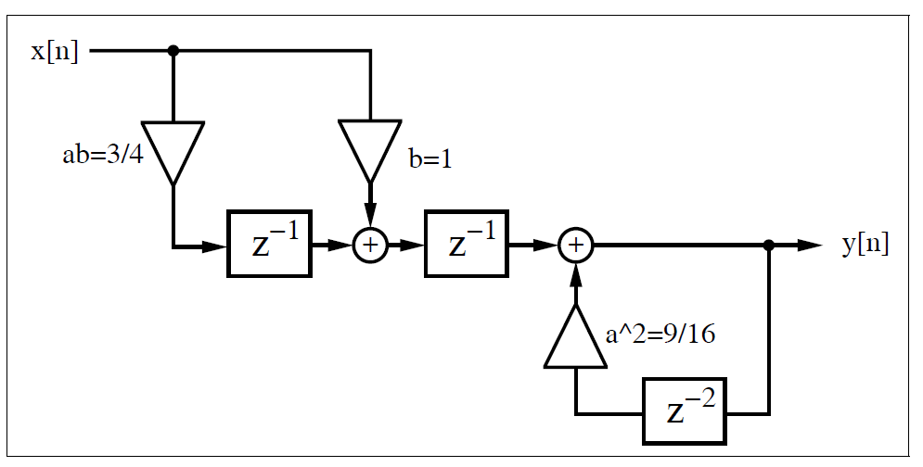
Fig. 11.14. Lossy integrator with look-ahead arithmetic.

Slide 38
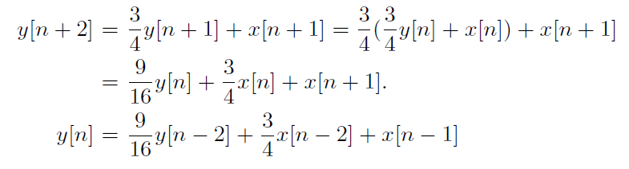
Example 11.3: Lossy Integrator II
Consider again the lossy integrator from Example 11.1, but now with look-ahead. Figure 11.14 shows the look-ahead lossy integrator, which is a combination of a nonrecursive part (i.e., FIR filter for x), and a recursive part with delay 2 and coefficient 9/16.
File: iir_pipe.vhdl OR iir_pipe.v
(11.13)
(11.14)
(11.15)

Slide 39
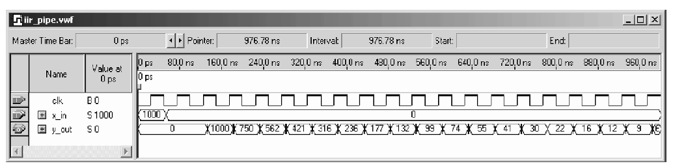
The pipelined adder and multiplier in this example are implemented in two steps. In the first stage, (9/16) y[n] is computed. In the second stage, x[n + 1]+ 3/4x[n] and 9/16 y[n] are added. The design uses 124 LEs, no embedded multiplier and has a 207.08MHz Registered Performance. The response of the filter to an impulse of amplitude 1000 is shown in Fig. 11.15.
Fig. 11.15. VHDL simulation of impulse response of the look-ahead lossy integrator.

Slide 40
Comparing the look-ahead scheme with the 62 LEs and 160.69MHz solution reported in Example 11.1, we find that look-ahead pipelining requires many more resources, but attains a speed-up of about 30%.
The comparison of the two filter’s response to the impulse with amplitude 1000 shown in Fig. 11.3 and Fig. 11.15 reveals that the look-ahead scheme has an additional overall delay, and that the quantization effect differs by a ±2 amount between the two methodologies.
An alternative design approach, using a standard logic vector data type and LPM_ADD_SUB megafunctions. The second approach will produce longer VHDL code, but will have the benefit of direct control at the bit level of the sign extension and multiplier.

Slide 41

11.4.2 Clustered and Scattered Look-Ahead Pipelining
Clustered and scattered look-ahead pipelining schemes add self-canceling poles and zeros to the design to facilitate pipelining of the recursive portion of the filter.
In the clustered method, additional pole/zeros are introduced in such a way that in the denominator of the transfer function the coefficients for z⁻¹, z⁻², . . . , z^{−(S−1)} become zero. The following example shows clustering for a second-order filter.
Example 11.4: Clustering Method
A second-order transfer function is assumed to have a pole at 1/2 and ¾ and a transfer function given by:
Adding a canceling pole/zero at z = −1.25 results in a new transfer function
The recursive part of the filter can now be implemented with an additional pipeline stage.

Slide 42
The problem with clustering is that the cancelled pole/zero pair may lie outside the unit circle, as is the case in the previous example (i.e., z∞ = −1.25). This introduces instability into the design if the pole/zero annihilating is not perfect. In general, a second-order system with poles at r1, r2 and with one extra canceling pair, has a pole location at −(r1 + r2), which lies outside the unit circle for |r1 + r2| > 1. Soderstrand et al., have described a stable clustering method, which in general introduces more than one canceling pole/zero pair.
The scattered look-ahead approach does not introduce stability problems. It introduces (S − 1) canceling pole/zero pairs located at zk = pejπk/S, for an original filter with a pole located at p. The denominator of the transfer function has, as a result, only zero coefficients associated with the terms z⁰, z^{S}, z^{−2S}, etc.

Slide 43
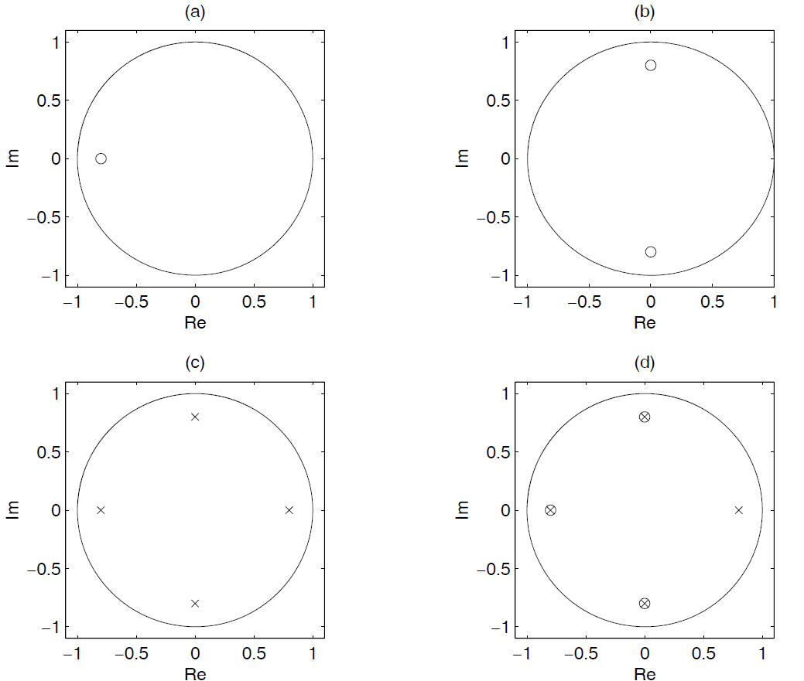
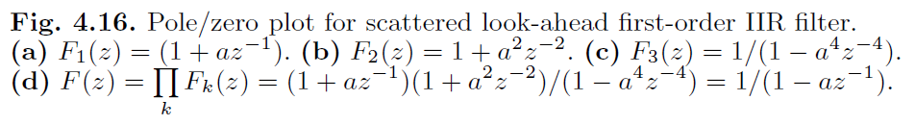
Fig. 11.16

Slide 44


Example 11.5: Scattered Look-Ahead Method
Consider implementing a second-order system having poles located at z∞1 = 0.5 and z∞2 = 0.75 with two additional pipeline stages. A second-order transfer function of a filter with poles at 1/2 and 3/4 has the transfer function
Note that in general a pole/zero pair at p and p∗ results in a transfer function of
and in particular with p = r × exp(j2π/3) it follows that

Slide 45
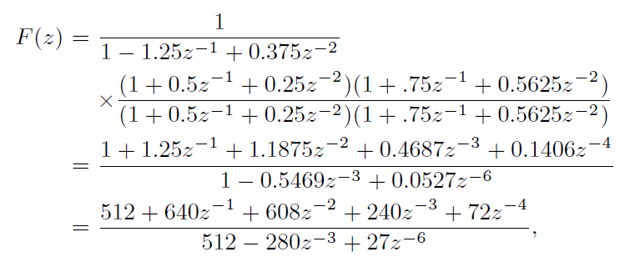
The scattered look-ahead introduces two additional pipeline stages by adding pole/zero pairs at 0.5e ±j2π/3 and 0.75e ±j2π/3. Adding a canceling pole/zero at this location results in
and the recursive part can be implemented with two additional pipeline stages.

Slide 46

It is interesting to note that for a first-order IIR system, clustered and scattered look-ahead methods result in the same pole/zero canceling pair lying on a circle around the origin with angle differences 2π/S. The nonrecursive part can be realized with a “power-of-two decomposition” according to
Figure 11.16 shows such a pole/zero representation for a first-order section, which enables an implementation with four pipeline stages in the recursive part.

Slide 47
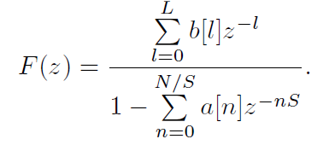
11.4.3 IIR Decimator Design
Martinez and Parks have introduced, in the context of decimation filters, a filter design algorithm based on the minimax method.
The resulting transfer function satisfies
That is, only every other S coefficient in the denominator is nonzero. In this case, the recursive part (i.e., the denominator) can be pipelined with S stages. It has been found that in the resulting pole/zero distribution, all zeros are on the unit circle, as is usual for an elliptic filter, while the poles lie on circles, whose main axes have a difference in angle of 2π/S, as shown in Fig. 11.17b.

Slide 48
11.4.4 Parallel Processing
In a parallel-processing filter implementation, P parallel IIR paths are formed, each running at a 1/P input sampling rate. They are combined at the output using a multiplexer, as shown in Fig. 11.18.
Because a multiplexer, in general, will be faster than a multiplier and/or adder, the parallel approach will be faster. Furthermore, each path P has a factor of P more time to compute its assigned output.
To illustrate, consider again a first-order system and P = 2. The lookahead scheme, as in (11.11)
y[n + 2] = ay[n + 1]+x[n + 1] = a2y[n] + ax[n] + x[n + 1] (11.21)
is now split into even n = 2k and odd n = 2k−1 output sequences, obtaining
y[n + 2] = y[2k + 2]=a2y[2k] + ax[2k] + x[2k + 1]
y[2k + 1]=a2y[2k − 1] + ax[2k − 1] + x[2k] , (11.22)
where n, k ∈ Z. The two equations are the basis for the following parallel IIR filter FPGA implementation.

Slide 49
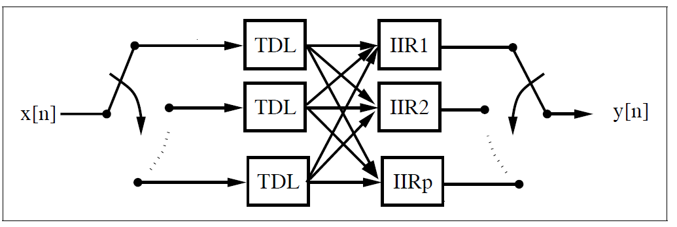
Fig. 11.18. Parallel IIR implementation. The tapped delay lines (TDL) run with a
1/p input sampling rate.

Slide 50
Example 11.6: Lossy Integrator III
Consider implementing a parallel lossy integrator, with a = 3/4, as an extension to the methods presented in Examples 11.1 and 11.3.
A two-channel parallel lossy integrator, which is a combination of two nonrecursive parts (i.e., an FIR filter for x), and two recursive parts with delay 2 and coefficient 9/16, is shown in Fig. 11.19. The VHDL code shown below implements the design. (iir_par.vhd)
The design is realized with two PROCESS statements. In the first, PROCESS Multiplex, x is split into even and odd indexed parts, and the output y is recombined at the clk rate. In addition, the first PROCESS statement generates the second clock, running at clk/2. The second block implements the
filter’s arithmetic according to (11.22). The design uses 268 LEs, no embedded multiplier, and has a 168.12MHz Registered Performance. The simulation is shown in Fig. 11.20.

Slide 51
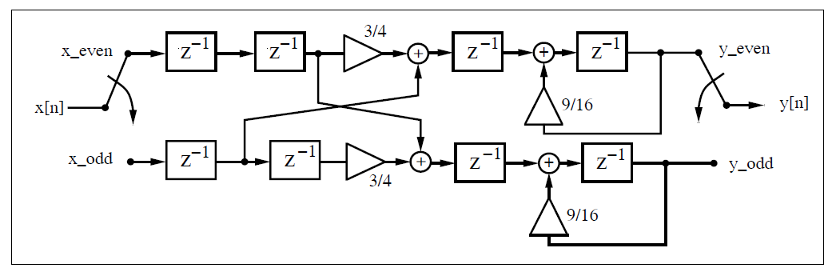
Fig. 11.19. Two-path parallel IIR filter implementation.

Slide 52
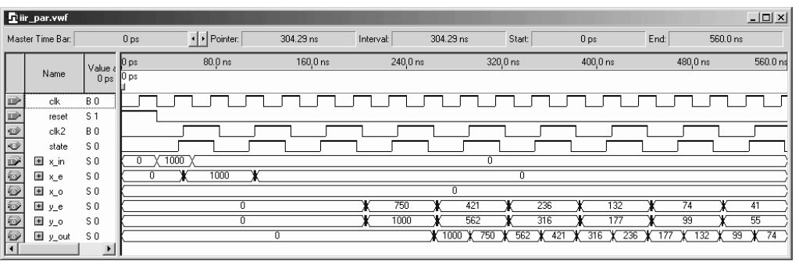
Fig. 11.20. VHDL simulation of the response of the parallel IIR filter to an impulse 1000.
The disadvantage of the parallel implementation, compared with the other methods presented, is the relatively high implementation cost of 268 LEs.

Slide 53
11.4.5 IIR Design Using RNS
Because the residue number system (RNS) uses an intrinsically short wordlength, it is an excellent candidate to implement fast (recursive) IIR filters. In a typical IIR-RNS design, a system is implemented as a collection of recursive and nonrecursive systems, each defined in terms of an FIR structure (see Fig. 11.21).
Each FIR may be implemented in RNS-DA, using a quarter-square
multiplier, or in the index domain, as developed in Chap. 10.
For a stable filter, the recursive part should be scaled to control dynamic range growth. The scaling operation may be implemented with mixed radix conversion, Chinese remainder theorem (CRT), or the −CRT method.
For high-speed designs, it is preferable to add an additional pipeline delay based on the clustered or scattered look-ahead pipelining technique.
It will be seen that RNS design will improve speed from 50MHz to more than 70MHz.

Slide 54
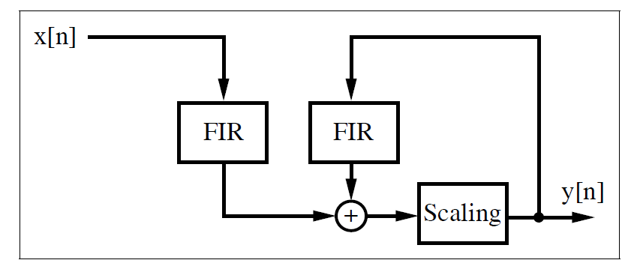
Fig. 11.21. RNS implementation of IIR filters using two FIR sections and scaling.

